Slide 1

English for Telephoning
Class: 18C1-NNA1
Time: 14.10 – 15.40 on
Lecturer: Ms. Nguyen Thi Thanh Tu
Faculty of Foreign Languages
Ly Tu Trong College of Ho Chi Minh City
Unit 4: When would suit you?

Slide 2
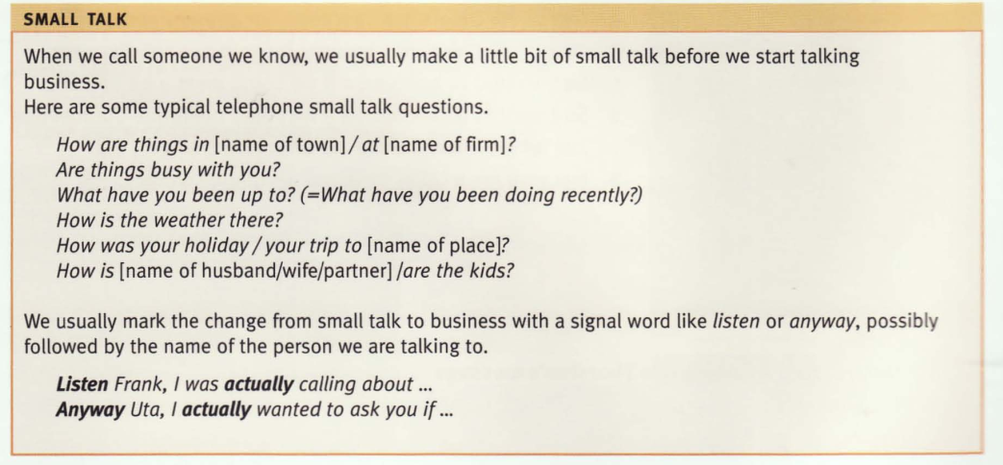

Slide 3
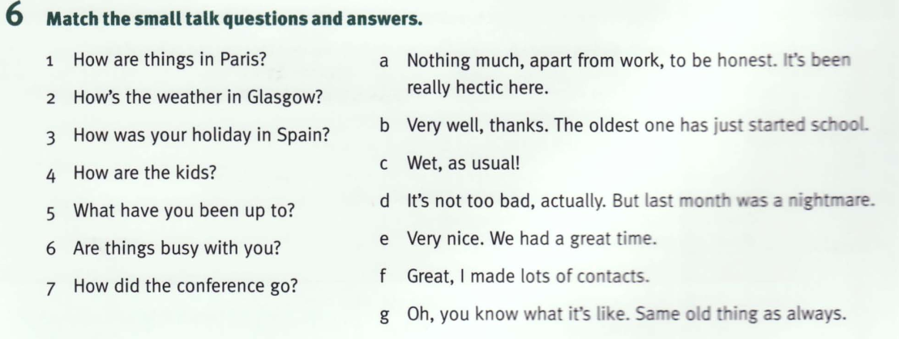

Slide 4
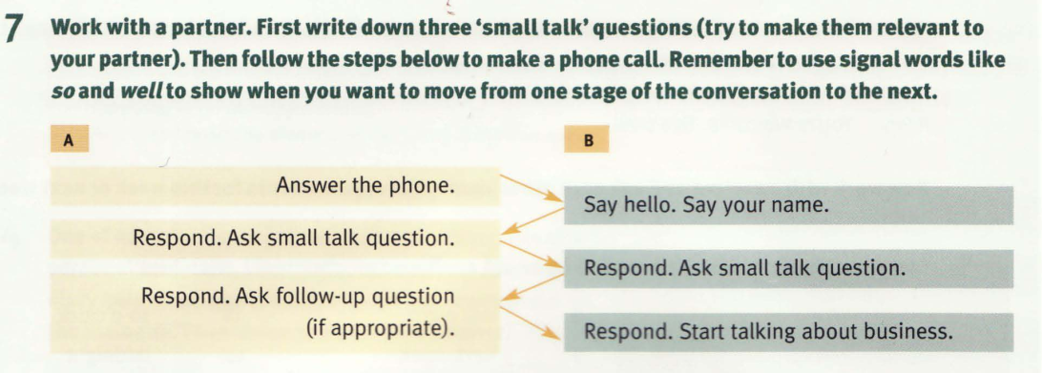

Slide 5
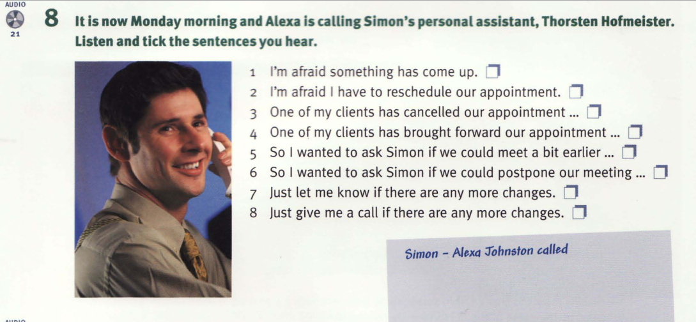

Slide 6
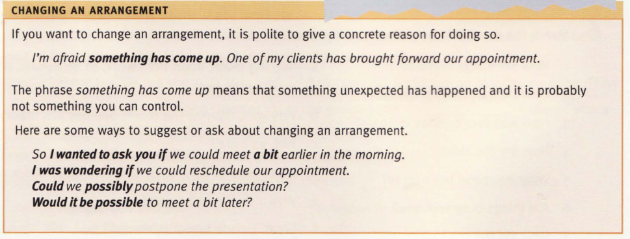

Slide 7
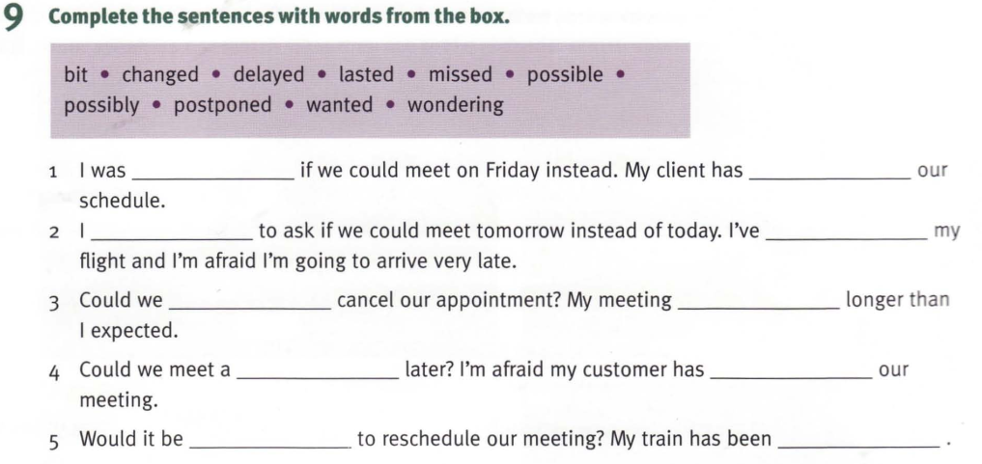

Slide 8
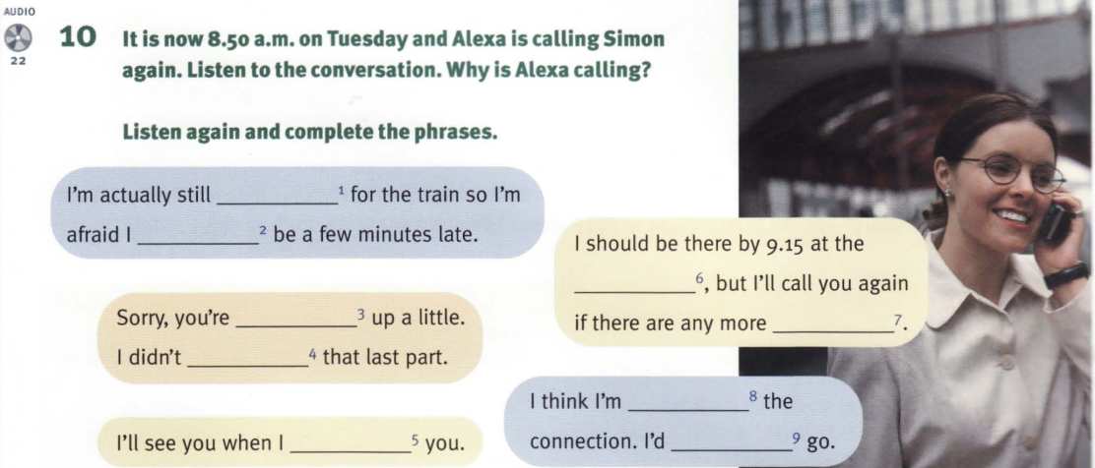

Slide 9
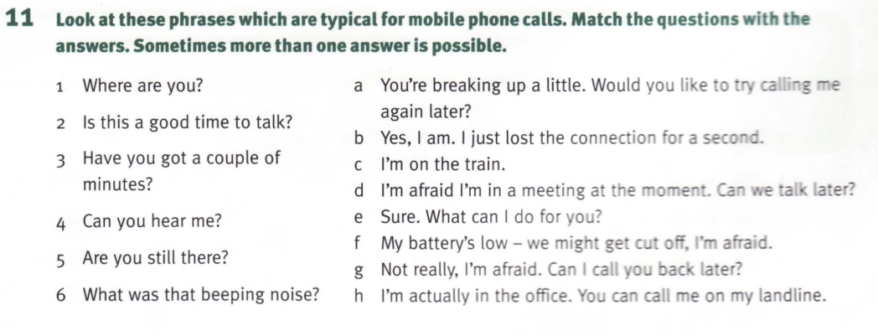

Slide 10
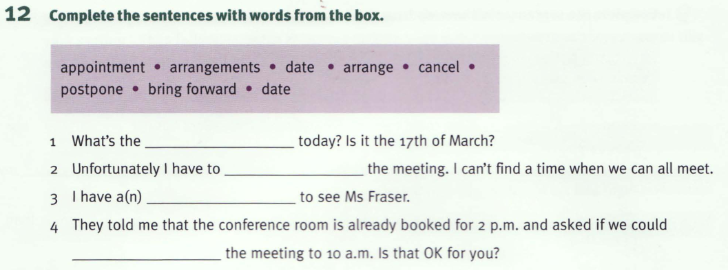
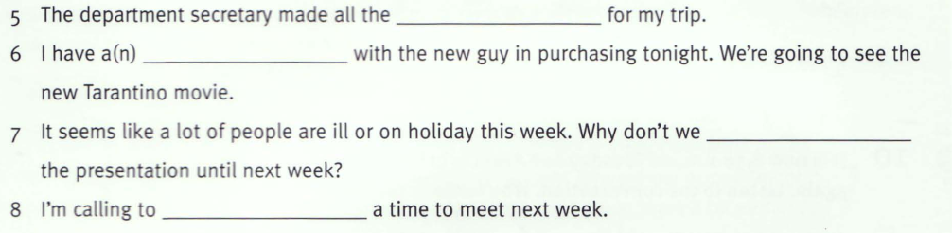

Slide 11
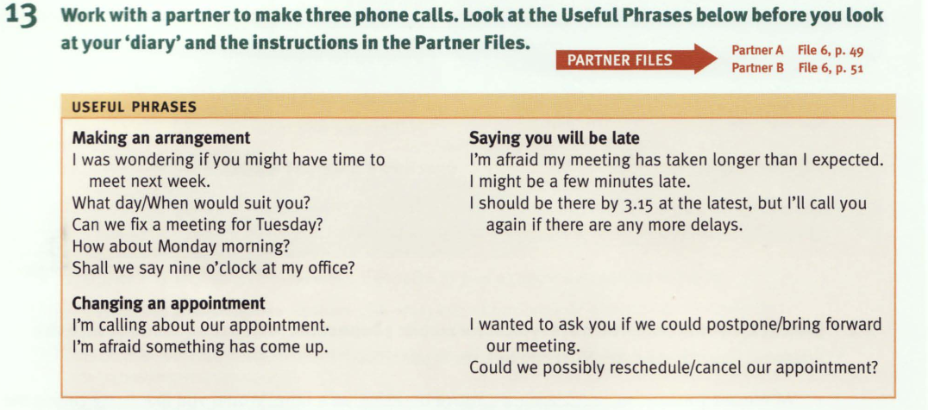

Slide 12
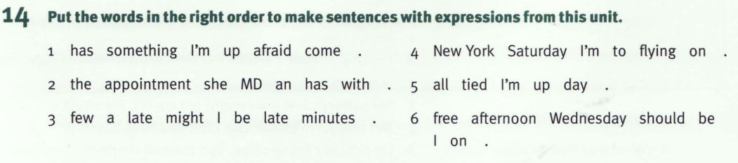

Slide 13
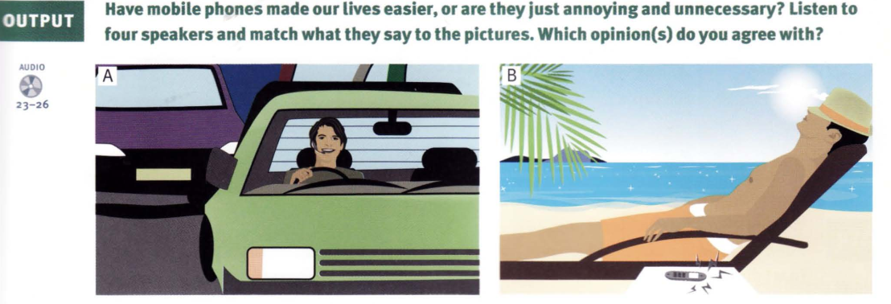
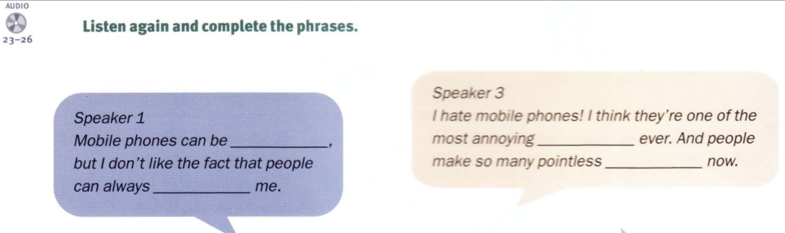

Slide 14
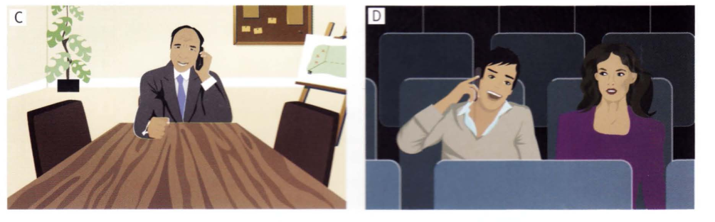
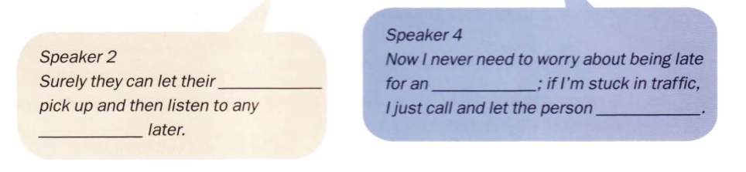

Slide 15
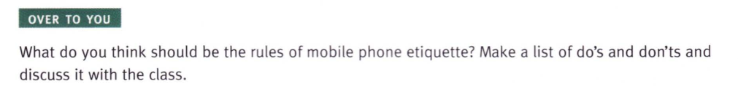
Homework:
After these two periods you have to learn all vocabulary.
Prepare for the rest parts of unit 4

